Slide 1

Fault Ride-Through Strategy for Two-Stage GPV System Enabling Load Compensation Capabilities Using EKF Algorithm
SUBMITTED BY
T. D. S. REDDY BABU (18781D0703)
Electrical Power Systems
Master’s Technology
Department of EEE
Under the guidance of
G. VENKAT PRADEEP
M. Tech
Assistant. professor.
Department of EEE
SVCET(A) –CHITTOOR
SRI VENKATESWARA COLLEGE OF ENGINEERING & TECHNOLOGY
[AUTONOMOUS]
R.V.S Nagar, Chittoor, Accredited by NAAC ’A’ Grade & NBA,
Approved by AICTE, New Delhi, Affiliated to JNTUA, Ananathapuramu.
RANKED By NIRF 2019, MHRD

Slide 2
CONTENTS
Introduction
Abstract
Objective
Existing system
Proposed system
Obtained results
Comparison
Applications
Conclusion
Future scope
References

Slide 3
INTRODUCTION
Accounting to the recent developments in photovoltaic technology, the solar photovoltaic (PV) based renewable power generation has experienced a swift growth among the commercial and residential sector.
However, increased dissemination of solar PV power generation into the traditional grid, has led to various power quality problems, especially in distribution networks where a significant portion of renewable energy sources are connected.
The control schemes necessitate phase locked loops, which increases the system complexity in practical implementation and leads to mal-operation under distorted grid voltages. Recently, the power quality improvement in the distribution grid using nonlinear modal.

Slide 4
ABSTRACT
This project proposes an extended Kalman filter (EKF) based control strategy for fault ride-through operation in twostage grid-connected photovoltaic (GPV) system.
The controller accounts for nonlinear loads in the system, grid harmonic-currents elimination and grid-currents balancing even during the harmonic/distorted grid voltages.
For the ride-through operation, a limit is imposed on PV active power injection to prevent inverter over-currents and DC-link energy aggregation, which reduces the lifetime of DC-link capacitor.
The power quality improvement is ensured using EKF state estimator, which precisely estimates the fundamental load currents.

Slide 5
OBJECTIVE
The fault ride through control strategy is presented for twostage grid-interfaced solar PV system, that can handle harmonic/distorted grid voltages, caused at far radial ends in the distribution network, and still supply balanced and sinusoidal grid currents with THD with the limits depicted by IEEE Std. 519, despite severe voltage-sag faults.
EKF control estimates the fundamental load currents, without the prior knowledge of amplitude, phase and behavior of the disturbances present in the load currents.
The superior steady-state and dynamic performances of EKF based strategy over linear controllers are established

Slide 6
LITERATURE SURVEY
E.Hache, A. Palle, Describes the integration of variable renewable energy sources (RES) into power networks. The main goal is to confront the contents and trends of scientific literature with the eyes and projects of researchers on future topics and issues to be solved, especially in terms of the modeling of electrical systems. The project analyses the dynamics of publication, clusters of collaboration, and main topics studied.
B. Singh, A. Chandra, and K. Al-Haddad, describes Maintaining a stable level of power quality in the distribution network is a growing challenge due to increased use of power electronics converters in domestic, commercial and industrial sectors. Power quality deterioration is manifested in increased losses; poor utilization of distribution systems; mal-operation of sensitive equipment and disturbances to nearby consumers, protective devices, and communication systems.

Slide 7
V. L. Srinivas, S. Kumar, S. Bhim and S. Mishra, Presents a multipurpose three phase double stage grid interfaced photovoltaic (GPV) system using an adaptive nonlinear control strategy. Along with a peak power extraction from a photovoltaic (PV) array, the proposed system is capable of harmonics currents elimination, reactive power compensation, grid currents balancing and adaptive DC link voltage control. The fundamental and harmonics information from the polluted load current are precisely estimated using an adaptive observer.
S. Bhim and J. Solanki, Presents Distribution Static Compensator (DSTATCOM) is proposed for compensation of reactive power and unbalance caused by various loads in distribution system. An evaluation of three different methods is made to derive reference currents for a DSTATCOM. These methods are an instantaneous reactive power theory, a synchronous reference frame theory, and a new Adaline-based algorithm. The Adaline-based algorithm is an adaptive method for extracting reference current signals.

Slide 8
Existing System
The control strategies that consider dynamics of photovoltaic power plants are reported. The controller uses multiple proportional resonant (PR) controllers to achieve individual phase current compensation.
The system performance with PR controllers, is degraded under variation of the system frequency as it provides infinite gain at the selected harmonic frequencies.
EKF control estimates the fundamental load currents, without the prior knowledge of amplitude, phase and behavior of the disturbances present in the load currents.
The superior steady-state and dynamic performances of EKF based strategy over linear controllers are established.

Slide 9
Drawbacks of existing system
The non-ideal implementation of infinite gains could cause series of instability issues for practical grid interfaced DG systems.
These strategies do not contribute for power quality improvement during nonlinear loads and harmonic voltages in the system.
Moreover, the zero-sequence and negative-sequence powers are produced by unbalanced currents with unbalanced voltages, which badly affect different commercial loads and industrial loads connected at the higher end of the distribution system such as three-phase motor loads/ high power loads.

Slide 10
Proposed system
The EKF state-estimator based control strategy is proposed for fault ride through operation in two-stage grid interfaced PV system, which enables the load compensation features in three phase distribution system.
The converter over-currents caused due to low voltage sags in the GPV system, are avoided, by providing an auxiliary reactive power support as recommended by IEEE Standard-1547.4.
Here, the ride-through operation is achieved without compromising the load compensation features such as grid harmonic currents elimination, grid currents balancing and power factor correction.

Slide 11
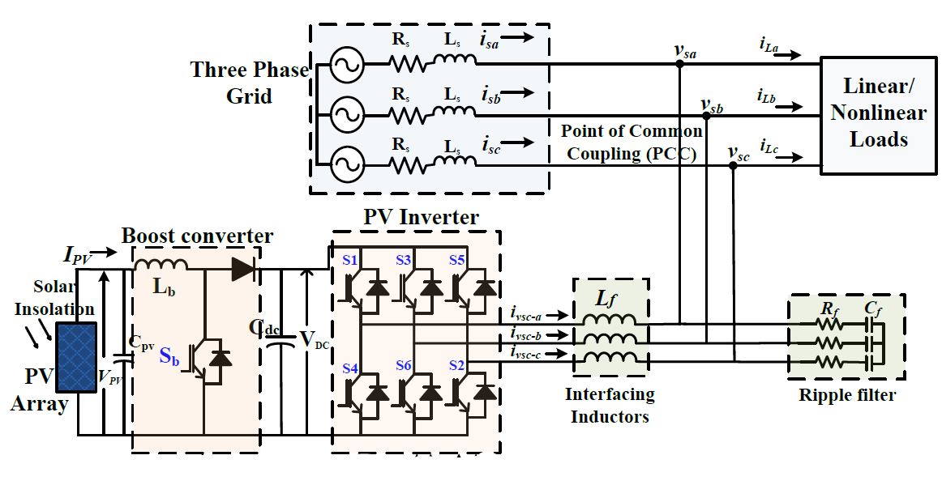

Block Diagram for Proposed system

Slide 12
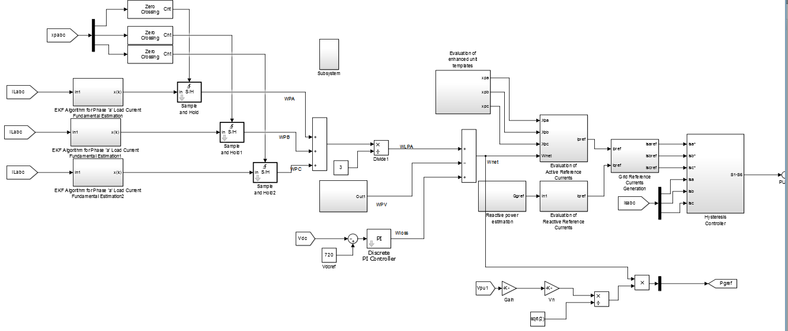
Simulation diagram of Existing system

Slide 13
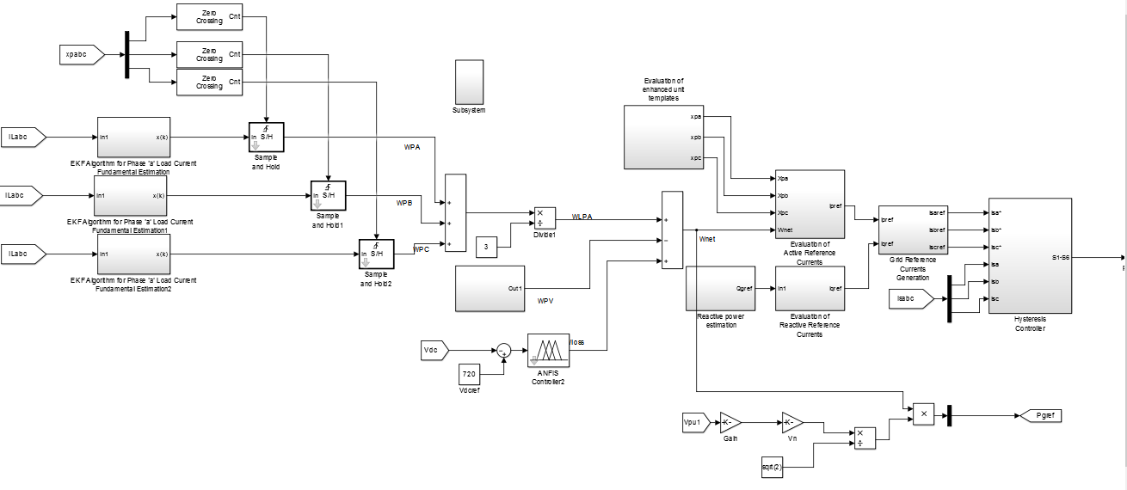
Simulation diagram of Proposed system

Slide 14
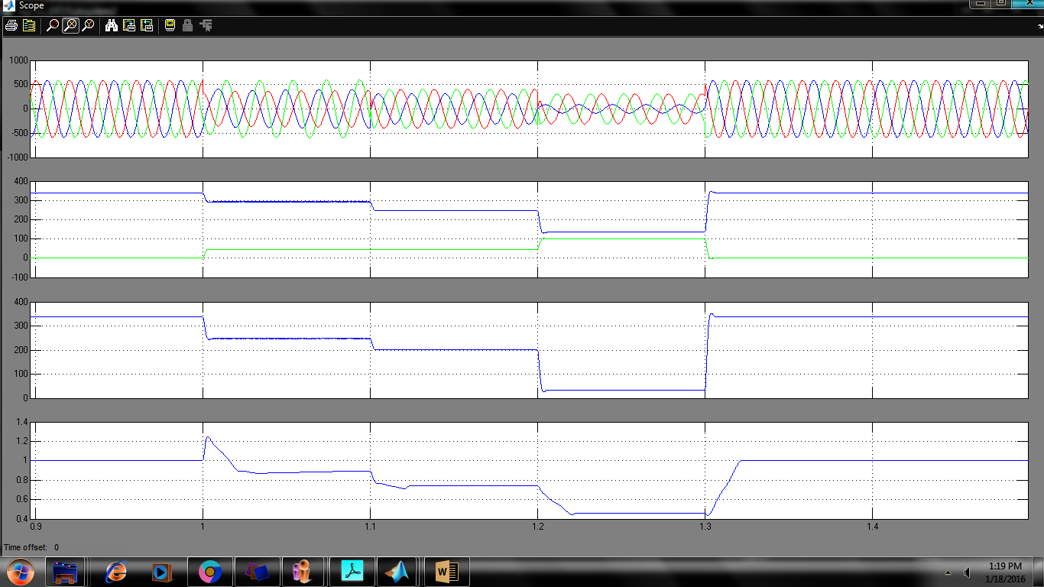
Simulation Results
Vsabc, V⁺ & V⁻, V⁺ -V⁻,Vpu

Slide 15
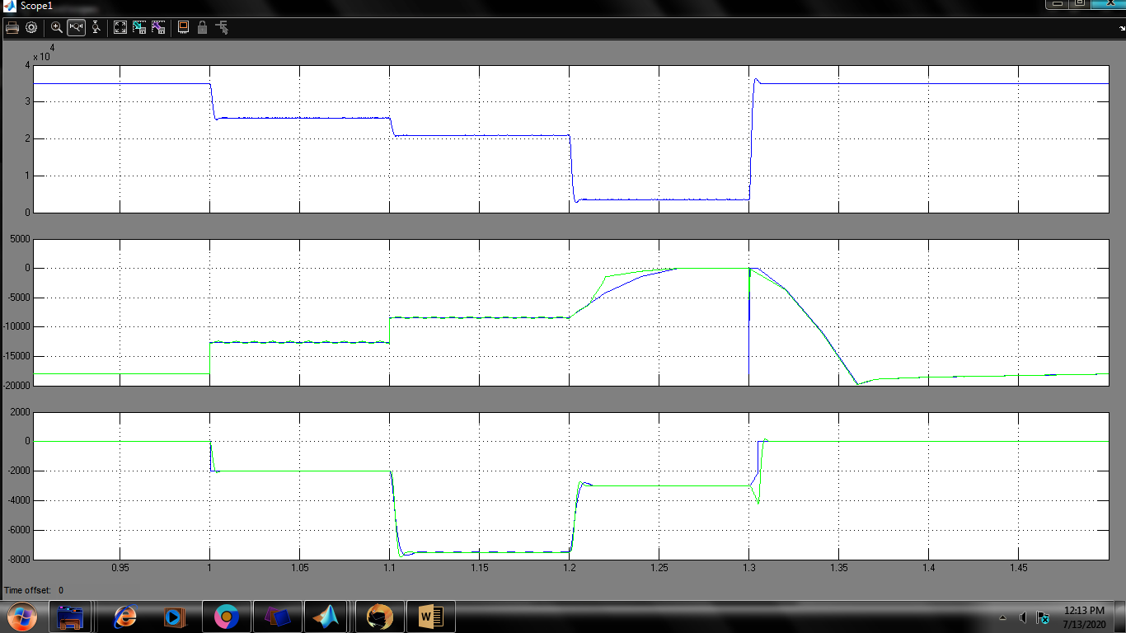
MNp,Pg,Qg

Slide 16
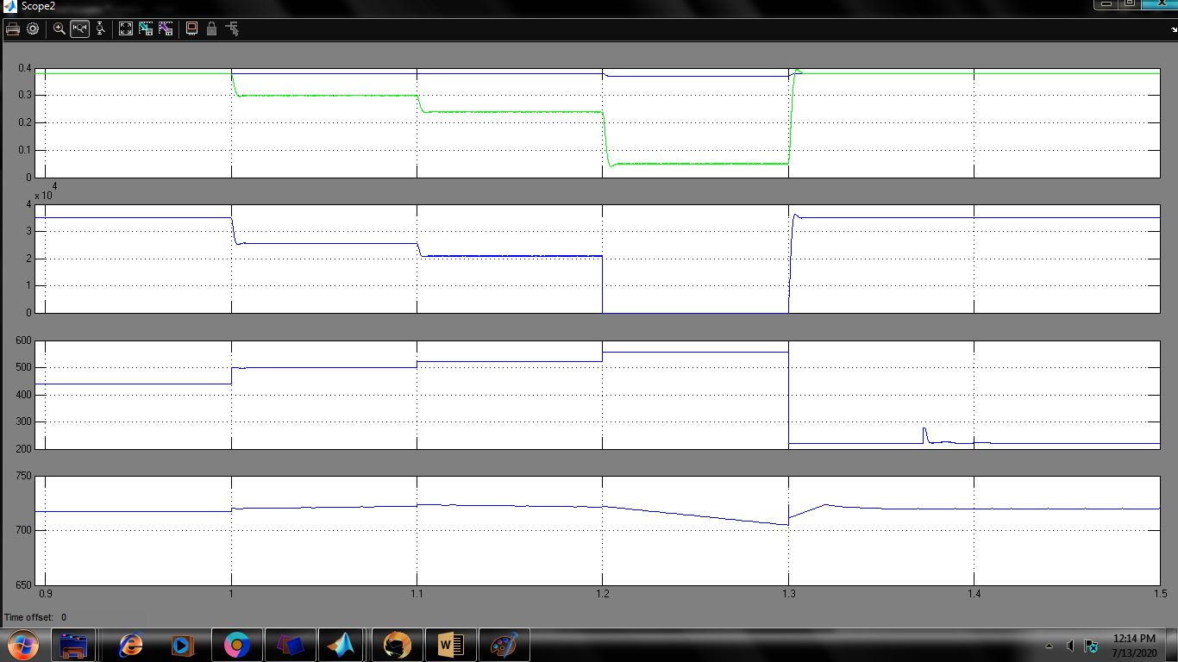
DboostPmax,Vpv,Vdc

Slide 17
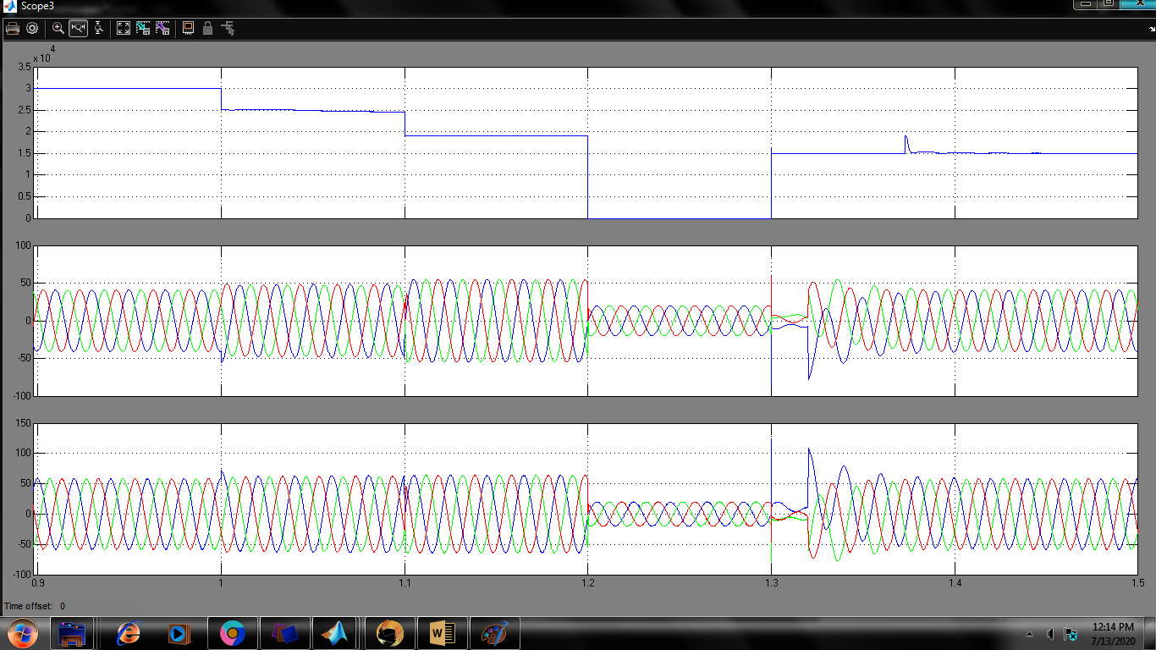
Ppv,Isabc,Ivsc

Slide 18
System response under L-G and L-L-G faults for Existing system

Slide 19
System response under L-G and L-L-G faults depicting fault ride-through operation of PV inverter

Slide 20
Advantages of Proposed system
Contrary to several control strategies on ride-through operation, this control strategy accounts for nonlinear loads in the system, and compensates for unbalanced/harmonic loads during the voltage-sag faults and harmonic voltages.
EKF control estimates the fundamental load currents, without the prior knowledge of amplitude, phase and behavior of the disturbances present in the load currents.
The superior steady-state and dynamic performances of EKF based strategy over linear controllers are established.

Slide 21
Comparisons between existing and proposed controllers
PI
ANFIS
The non-ideal implementation of infinite gains could cause series of instability issues for practical grid interfaced DG systems
Do not contribute for power quality improvement during nonlinear loads and harmonic voltages in the system.
Total Hormonic Distortion(THD) is 1.69
Doesn't find out fundamental load current exactly
Stability issues for practical grid interfaced DG systems in both cases
Contribute Power quality improvement during nonlinear loads and harmonic voltages in the system
Here, THD Value is 0.39
Its estimates fundamental load current precisely.

Slide 22
PI
ANFIS
The zero-sequence and negative-sequence powers are produced by unbalanced currents with unbalanced voltages, which badly affect different commercial loads and industrial loads connected at the higher end of the distribution system such as three-phase motor loads/ high power loads
The ride through operation of grid interfaced PV systems under low voltage sags, which ensures the different power-quality functionalities of harmonic current mitigation, power factor correction, balancing of grid currents, reliable operation during abnormal/harmonic grid voltages caused in distribution system

Slide 23
Applications
It is applied in EHV lines to eliminate THD and improve the power quality.
ANFIS can be employed in a wide variety of applications of
Modeling,
Decision making,
Signal processing, and
Control.

Slide 24
CONCLUSION
The EKF state-estimator based control strategy is proposed for fault ride through operation in two-stage grid interfaced PV system, which enables the load compensation features in three phase distribution system.
The results under distorted grid voltages and L-G unbalanced fault, are also presented. Under both normal and abnormal grid conditions, the grid currents with proposed control strategy, are balanced and are maintained within the THD limit recommended by the IEEE standard-519.
The practical grid interfaced PV systems, are subject to continuous grid side perturbations and proposed control strategy serves as a possible solution, owing to its multi-functional features and self-adaptation capability to the variations in grid-side parameters.

Slide 25
FUTURE SCOPE
This method is presently tested on IEEE test system which can further be extended to practical systems.
The primary objective here is Under both normal and abnormal grid conditions, the grid currents with proposed control strategy, are balanced and are maintained within the THD limit.

Slide 26
REFERENCES
[1] E.Hache, A. Palle, “Renewable energy source integration into power networks, research trends and policy implications: A bibliometric and research actors survey analysis”, Energy Policy, vol. 124, pp. 23-35, 2019.
[2] B. Singh, A. Chandra, and K. Al-Haddad, Power Quality: Problems and Mitigation Techniques. Hoboken, NJ, USA: Wiley, Jan. 2015.
[3] V. L. Srinivas, S. Kumar, S. Bhim and S. Mishra, "A Multifunctional GPV System Using Adaptive Observer Based Harmonic Cancellation Technique," IEEE Trans.Ind. Electron., vol. 65, no. 2, pp. 1347-1357, 2018..
[4] S. Bhim and J. Solanki, “A comparison of control algorithms for DSTATCOM,” IEEE Trans. Ind. Electr., vol. 56, no. 7, pp. 2738-2745, July 2009.

Slide 27


